Slide 1
Pizza Sales Data Analysis using SQL

Slide 2
Introduction
This project involves analyzing pizza sales data to uncover key business insights using SQL. The analysis covers total revenue, most popular pizza types, and sales trends, providing a comprehensive overview of customer preferences and performance metrics.

Slide 3
ORDERS .CSV
order_id | date | time
1 | 1/1/2015 | 11:38:36
2 | 1/1/2015 | 11:57:40
3 | 1/1/2015 | 12:12:28
4 | 1/1/2015 | 12:16:31
5 | 1/1/2015 | 12:21:30
6 | 1/1/2015 | 12:29:36
7 | 1/1/2015 | 12:50:37

Slide 4
ORDERS_DETAIL.CSV
order_details_id | order_id | pizza_id | quantity
1 | 1 | hawaiian_m | 1
2 | 2 | classic_dlx_m | 1
3 | 2 | five_cheese_l | 1
4 | 2 | ital_supr_l | 1
5 | 2 | mexicana_m | 1
6 | 2 | thai_ckn_l | 1
7 | 3 | ital_supr_m | 1
8 | 3 | prsc_argla_l | 1
9 | 4 | ital_supr_m | 1
10 | 5 | ital_supr_m | 1

Slide 5
PIZZAS.CSV
pizza_id | pizza_type_id | size | price
bbq_ckn_s | bbq_ckn | S | 12.75
bbq_ckn_m | bbq_ckn | M | 16.75
bbq_ckn_l | bbq_ckn | L | 20.75
cali_ckn_s | cali_ckn | S | 12.75
cali_ckn_m | cali_ckn | M | 16.75
cali_ckn_l | cali_ckn | L | 20.75
ckn_alfredo_s | ckn_alfredo | S | 12.75
ckn_alfredo_m | ckn_alfredo | M | 16.75
ckn_alfredo_l | ckn_alfredo | L | 20.75

Slide 6
PIZZA_TYPES.CSV
pizza_type_id | name | category | ingredients
bbq_ckn | The Barbecue Chicken Pizza | Chicken | Barbecued Chicken, Red Peppers, Green Peppers, Tomatoes, Red Onions, Barbecue Sauce
cali_ckn | The California Chicken Pizza | Chicken | Chicken, Artichoke, Spinach, Garlic, Jalapeno Peppers, Fontina Cheese, Gouda Cheese
ckn_alfredo | The Chicken Alfredo Pizza | Chicken | Chicken, Red Onions, Red Peppers, Mushrooms, Asiago Cheese, Alfredo Sauce
ckn_pesto | The Chicken Pesto Pizza | Chicken | Chicken, Tomatoes, Red Peppers, Spinach, Garlic, Pesto Sauce
southw_ckn | The Southwest Chicken Pizza | Chicken | Chicken, Tomatoes, Red Peppers, Red Onions, Jalapeno Peppers, Corn, Cilantro, Chipotle Sauce
thai_ckn | The Thai Chicken Pizza | Chicken | Chicken, Pineapple, Tomatoes, Red Peppers, Thai Sweet Chilli Sauce
big_meat | The Big Meat Pizza | Classic | Bacon, Pepperoni, Italian Sausage, Chorizo Sausage
classic_dlx | The Classic Deluxe Pizza | Classic | Pepperoni, Mushrooms, Red Onions, Red Peppers, Bacon
hawaiian | The Hawaiian Pizza | Classic | Sliced Ham, Pineapple, Mozzarella Cheese
ital_cpcllo | The Italian Capocollo Pizza | Classic | Capocollo, Red Peppers, Tomatoes, Goat Cheese, Garlic, Oregano

Slide 7
Import CSV File
-- TO ADD csv file to sql first make data base
CREATE DATABASE example;
-- then right click on tables and import project wizard
-- but if file is too large then make a table
create table orders(
order_id int not null,
order_date date not null,
order_time time not null,
primary key (order_id))
-- then right click on orders and import project wizard

Slide 8

Retrieve the total number of orders placed.
SELECT
COUNT(order_id)
FROM
orders

Slide 9

Calculate the total revenue generated from pizza sales.
SELECT
ROUND(SUM(order_detail.quanity * pizzas.price),
2) AS Total_Revenue
FROM
order_detail
JOIN
pizzas ON order_detail.pizza_id = pizzas.pizza_id

Slide 10

Identify the highest-priced pizza.
SELECT
pizza_types.name, pizzas.price AS Max_Price
FROM
pizzas
JOIN
pizza_types ON pizzas.pizza_type_id = pizza_types.pizza_type_id
ORDER BY pizzas.price DESC
LIMIT 1

Slide 11
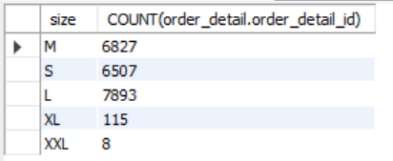
Identify the most common pizza size ordered.
SELECT
pizzas.size, COUNT(order_detail.order_detail_id)
FROM
order_detail
JOIN
pizzas ON pizzas.pizza_id = order_detail.pizza_id
GROUP BY pizzas.size

Slide 12
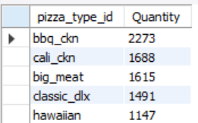
List the top 5 most ordered pizza types along with their quantities.
SELECT
ROUND(SUM(order_detail.quanity * pizzas.price),
2) AS Total_Revenue
FROM
order_detail
JOIN
pizzas ON order_detail.pizza_id = pizzas.pizza_id

Slide 13
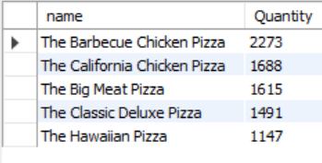
List the top 5 most ordered pizza types along with their quantities.
SELECT
pizza_types.name, COUNT(order_detail.quanity) as Quantity
FROM
order_detail
JOIN
pizzas ON pizzas.pizza_id = order_detail.pizza_id
JOIN
pizza_types ON pizzas.pizza_type_id = pizza_types.pizza_type_id
GROUP BY pizza_types.name
order by Quantity desc limit 5

Slide 14
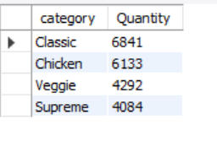
Join the necessary tables to find the total quantity of each pizza category ordered.
SELECT
pizza_types.category,
COUNT(order_detail.quanity) AS Quantity
FROM
pizza_types
JOIN
pizzas ON pizzas.pizza_type_id = pizza_types.pizza_type_id
JOIN
order_detail ON pizzas.pizza_id = order_detail.pizza_id
GROUP BY pizza_types.category
ORDER BY Quantity DESC
LIMIT 5

Slide 15
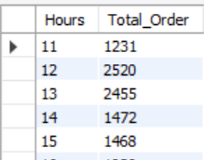
Determine the distribution of orders by hour of the day.
SELECT
HOUR(order_time) AS Hours, COUNT(order_id) AS Total_Order
FROM
orders
GROUP BY HOUR(order_time)

Slide 16
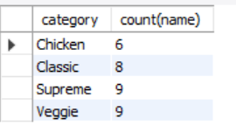
Join relevant tables to find the category-wise distribution of pizzas.
select category,count(name)
FROM pizza_types
group by category

Slide 17
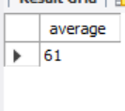
Group the orders by date and calculate the average number of pizzas ordered per day.
SELECT
round(AVG(Total_Order),0) AS average
FROM
(SELECT
orders.order_date, SUM(order_detail.quanity) AS Total_Order
FROM
orders
JOIN order_detail ON orders.order_id = order_detail.order_id
GROUP BY orders.order_date) AS order_per_day;

Slide 18
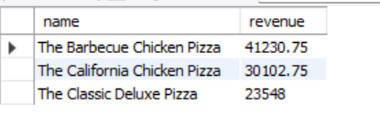
Determine the top 3 most ordered pizza types based on revenue.
SELECT
pizza_types.name,
ROUND(SUM(order_detail.quanity * pizzas.price),
2) AS revenue
FROM
pizza_types
JOIN
pizzas ON pizzas.pizza_type_id = pizza_types.pizza_type_id
JOIN
order_detail ON pizzas.pizza_id = order_detail.pizza_id
GROUP BY pizza_types.name
ORDER BY revenue DESC
LIMIT 3

Slide 19
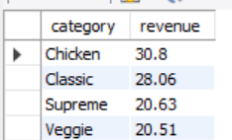
Calculate the percentage contribution of each pizza type to total revenue.
SELECT
pizza_types.category,
Round(SUM(order_detail.quanity * pizzas.price) /
(SELECT SUM(order_detail.quanity * pizzas.price)
FROM order_detail JOIN
pizzas ON order_detail.pizza_id = pizzas.pizza_id)*100,2) as revenue
FROM
pizza_types
JOIN
pizzas ON pizzas.pizza_type_id = pizza_types.pizza_type_id
JOIN
order_detail ON pizzas.pizza_id = order_detail.pizza_id
GROUP BY pizza_types.category
ORDER BY revenue DESC

Slide 20
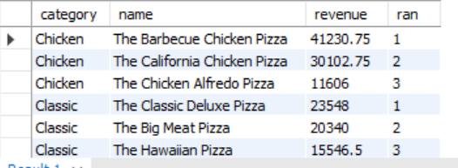
Determine the top 3 most ordered pizza types based on revenue for each pizza category.
select category,name,revenue,ran
from
(select category,name,revenue,
RANK() OVER(partition by category order by revenue desc) as ran
from
(SELECT
pizza_types.category,pizza_types.name,
ROUND(SUM(order_detail.quanity * pizzas.price),
2) AS revenue
FROM
pizza_types
JOIN
pizzas ON pizzas.pizza_type_id = pizza_types.pizza_type_id
JOIN
order_detail ON pizzas.pizza_id = order_detail.pizza_id
GROUP BY pizza_types.name,pizza_types.category
ORDER BY revenue DESC) as a) as b
where ran<=3;

